Slide 1
How Deploy Codeigniter Project in Azure using FTP

Slide 3
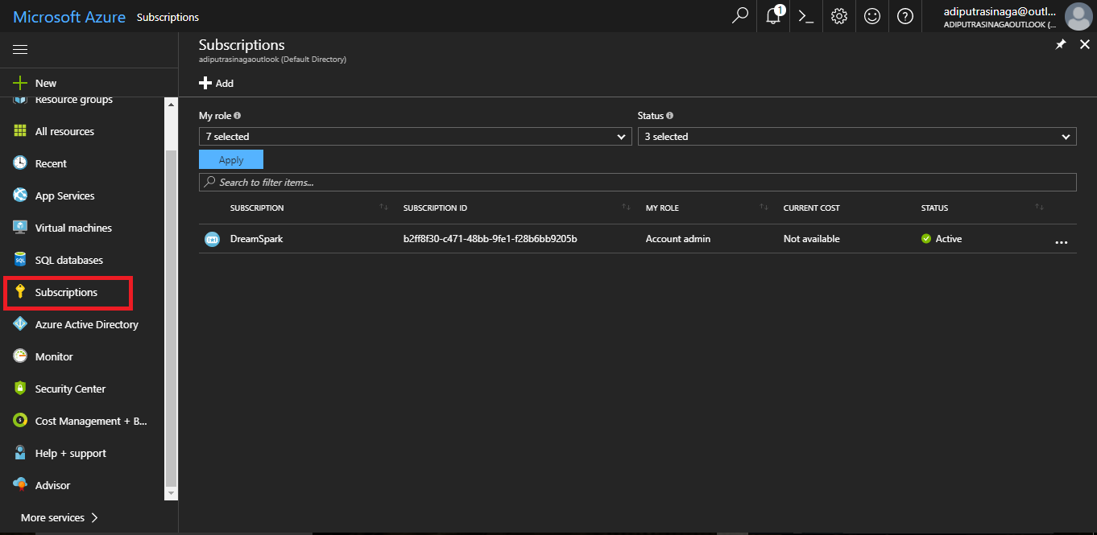
Check your Subscription?

Slide 4
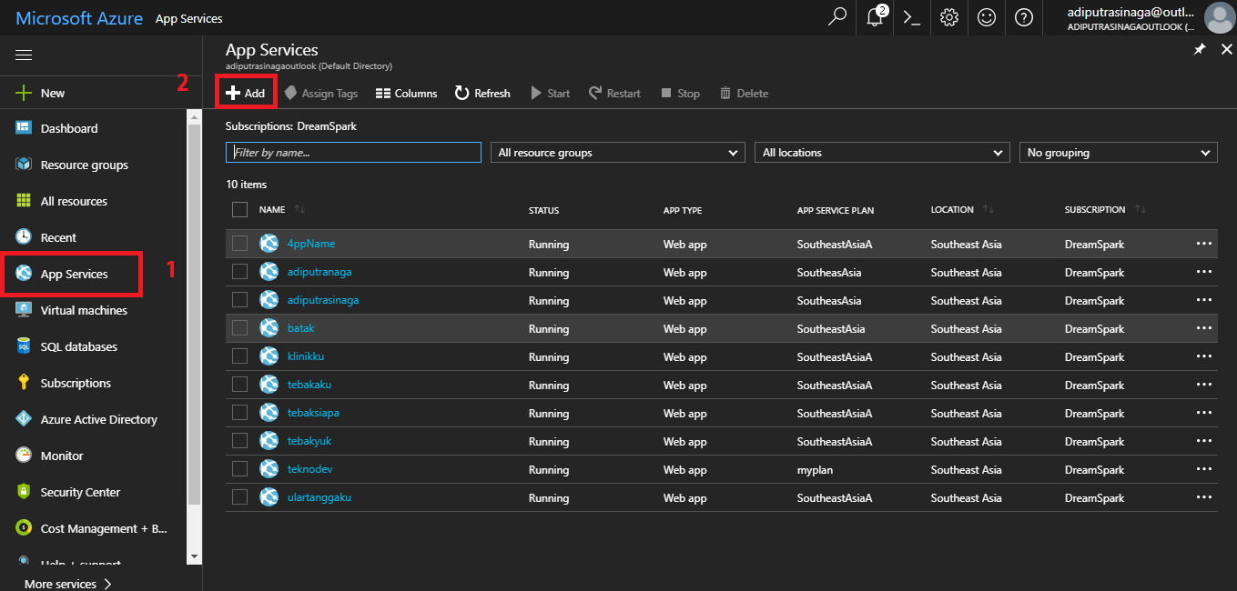
Deploy Codeigniter Project in Azure - 1

Slide 5
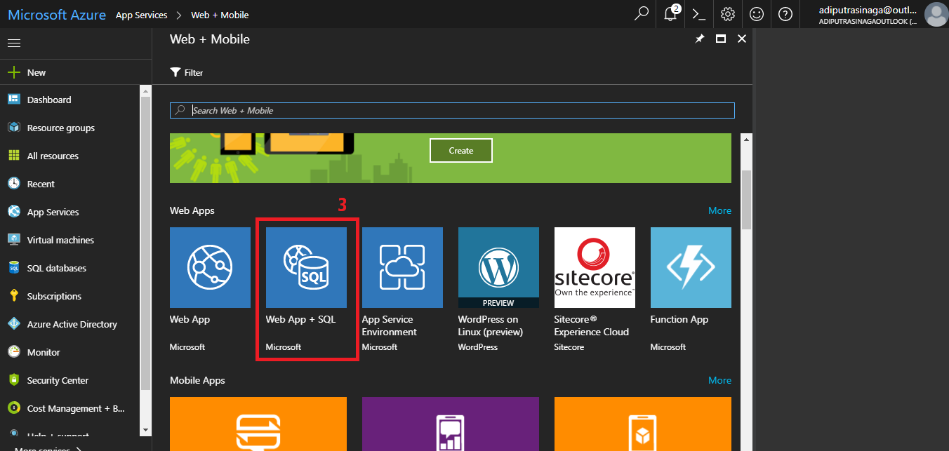
Deploy Codeigniter Project in Azure - 2

Slide 6
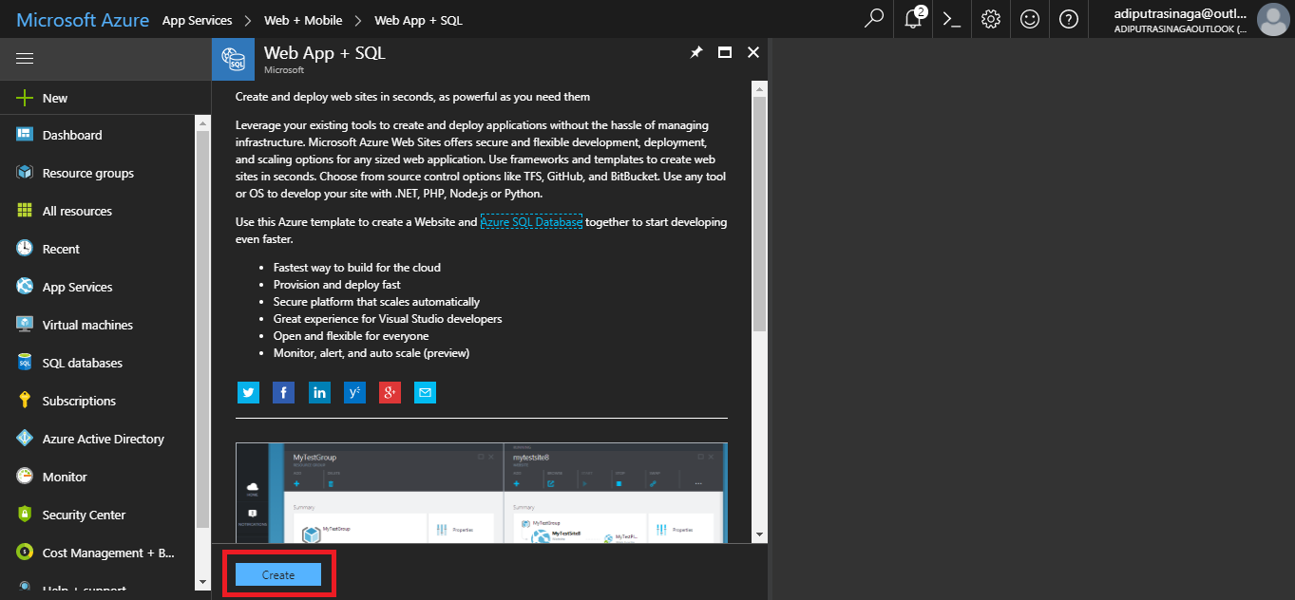
Deploy Codeigniter Project in Azure - 3

Slide 7
Deploy Codeigniter Project in Azure - 4

Slide 8
Deploy Codeigniter Project in Azure - 5

Slide 9
Deploy Codeigniter Project in Azure - 6

Slide 10
Deploy Codeigniter Project in Azure - 7

Slide 11
Deploy Codeigniter Project in Azure - 8

Slide 12
Deploy Codeigniter Project in Azure - 9

Slide 13
Deploy Codeigniter Project in Azure - 10

